Slide 1
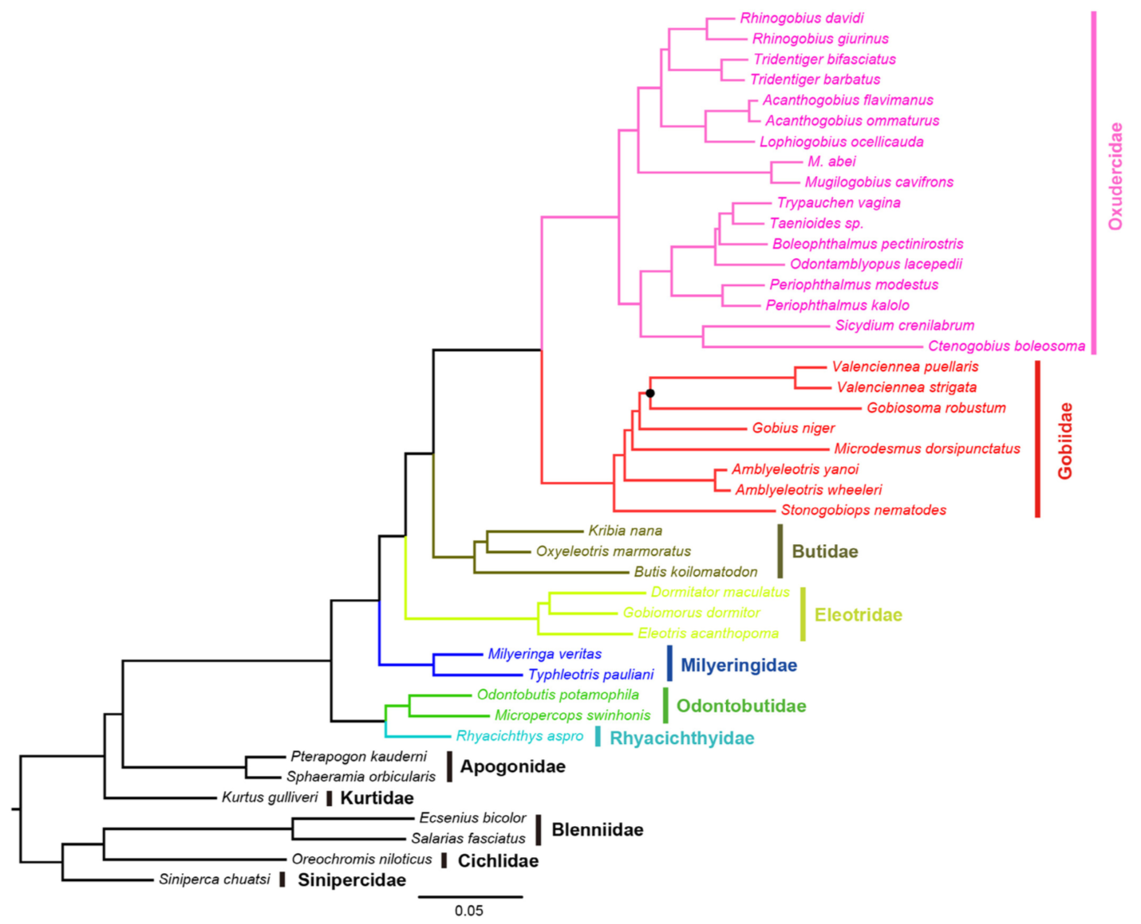
Exon-capture to Phylogeny
FISH 546 – Bioinformatics, 2018
Calder Atta
Disclaimer:
I did not make this. =>

Slide 2


Slide 3
FastQC
Raw Data
Question:
Can I replicate the methods used in Kuang et al. 2014?
Merge Lanes
Lab Work
Remove adapters and
low-quality reads
Samples
Remove duplicate reads from PCR
Targeted Exons
Parse reads to each locus
Assemble reads into contigs
I am here!
Merge loci with more than one contig
Downstream Analysis to
Generate Tree
Compare sequences to O. nilotics genome
Multiple sequence alignment

Slide 4
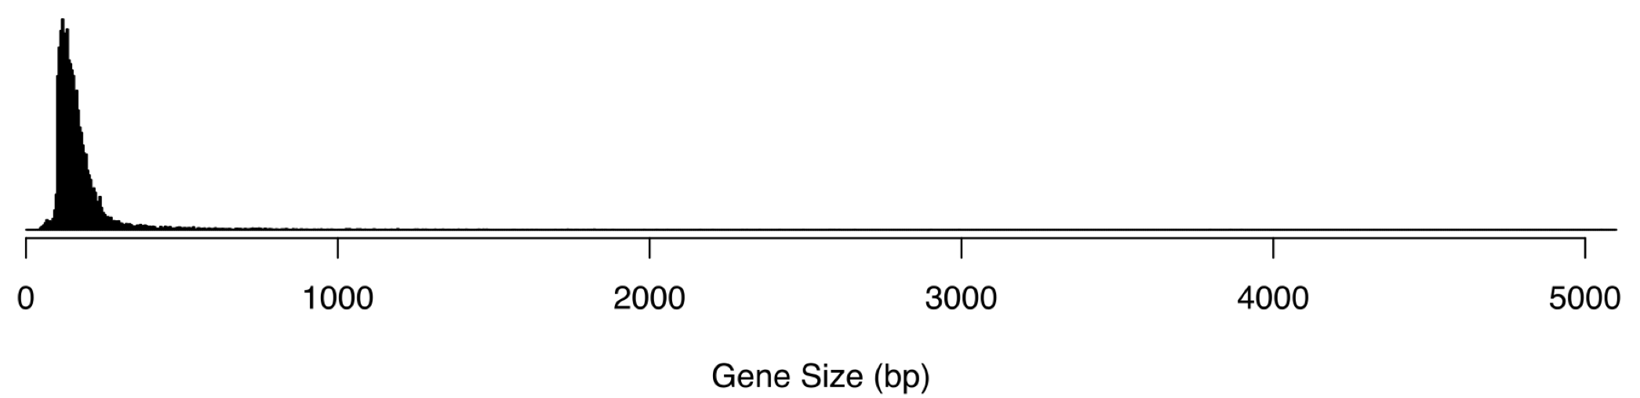
Targeted Exons
18,400 exons
3,302,187 bp in total
Derived from 8 species of fish for use on all bony-fishes
Exon Size Distribution

Slide 5
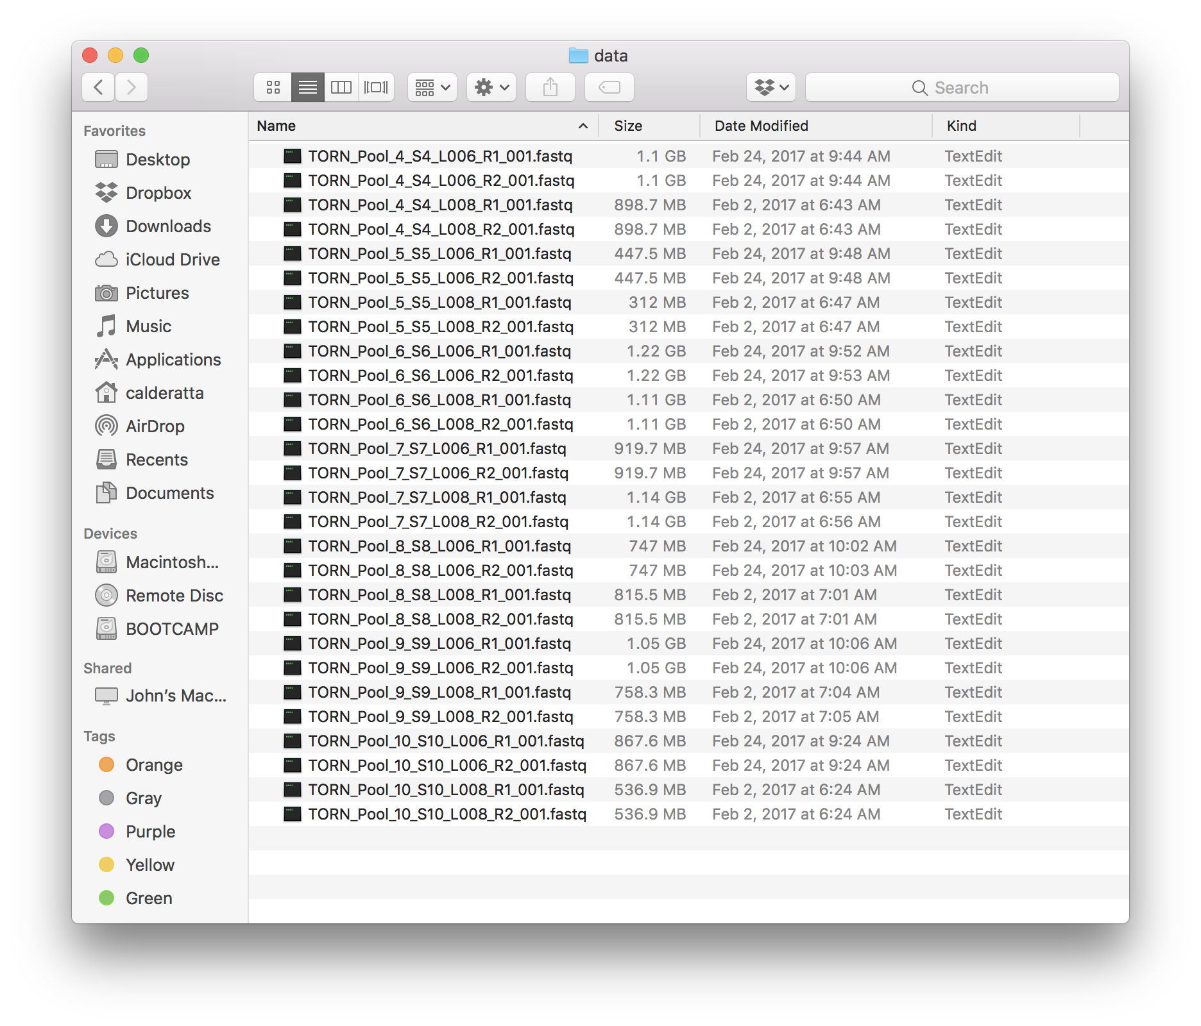
Raw Data
Testing protocol using 7 samples
from the original study
2 lanes x 2 forward/reverse = 4 files
1 Sample

Slide 6
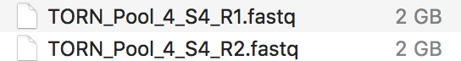
FastQC
Merge Lanes
cat
Merge Lanes
Remove adapters and
low-quality reads
Remove duplicate reads from PCR
Parse reads to each locus
Assemble reads into contigs
Merge loci with more than one contig
Compare sequences to O. nilotics genome
Multiple sequence alignment

Slide 7
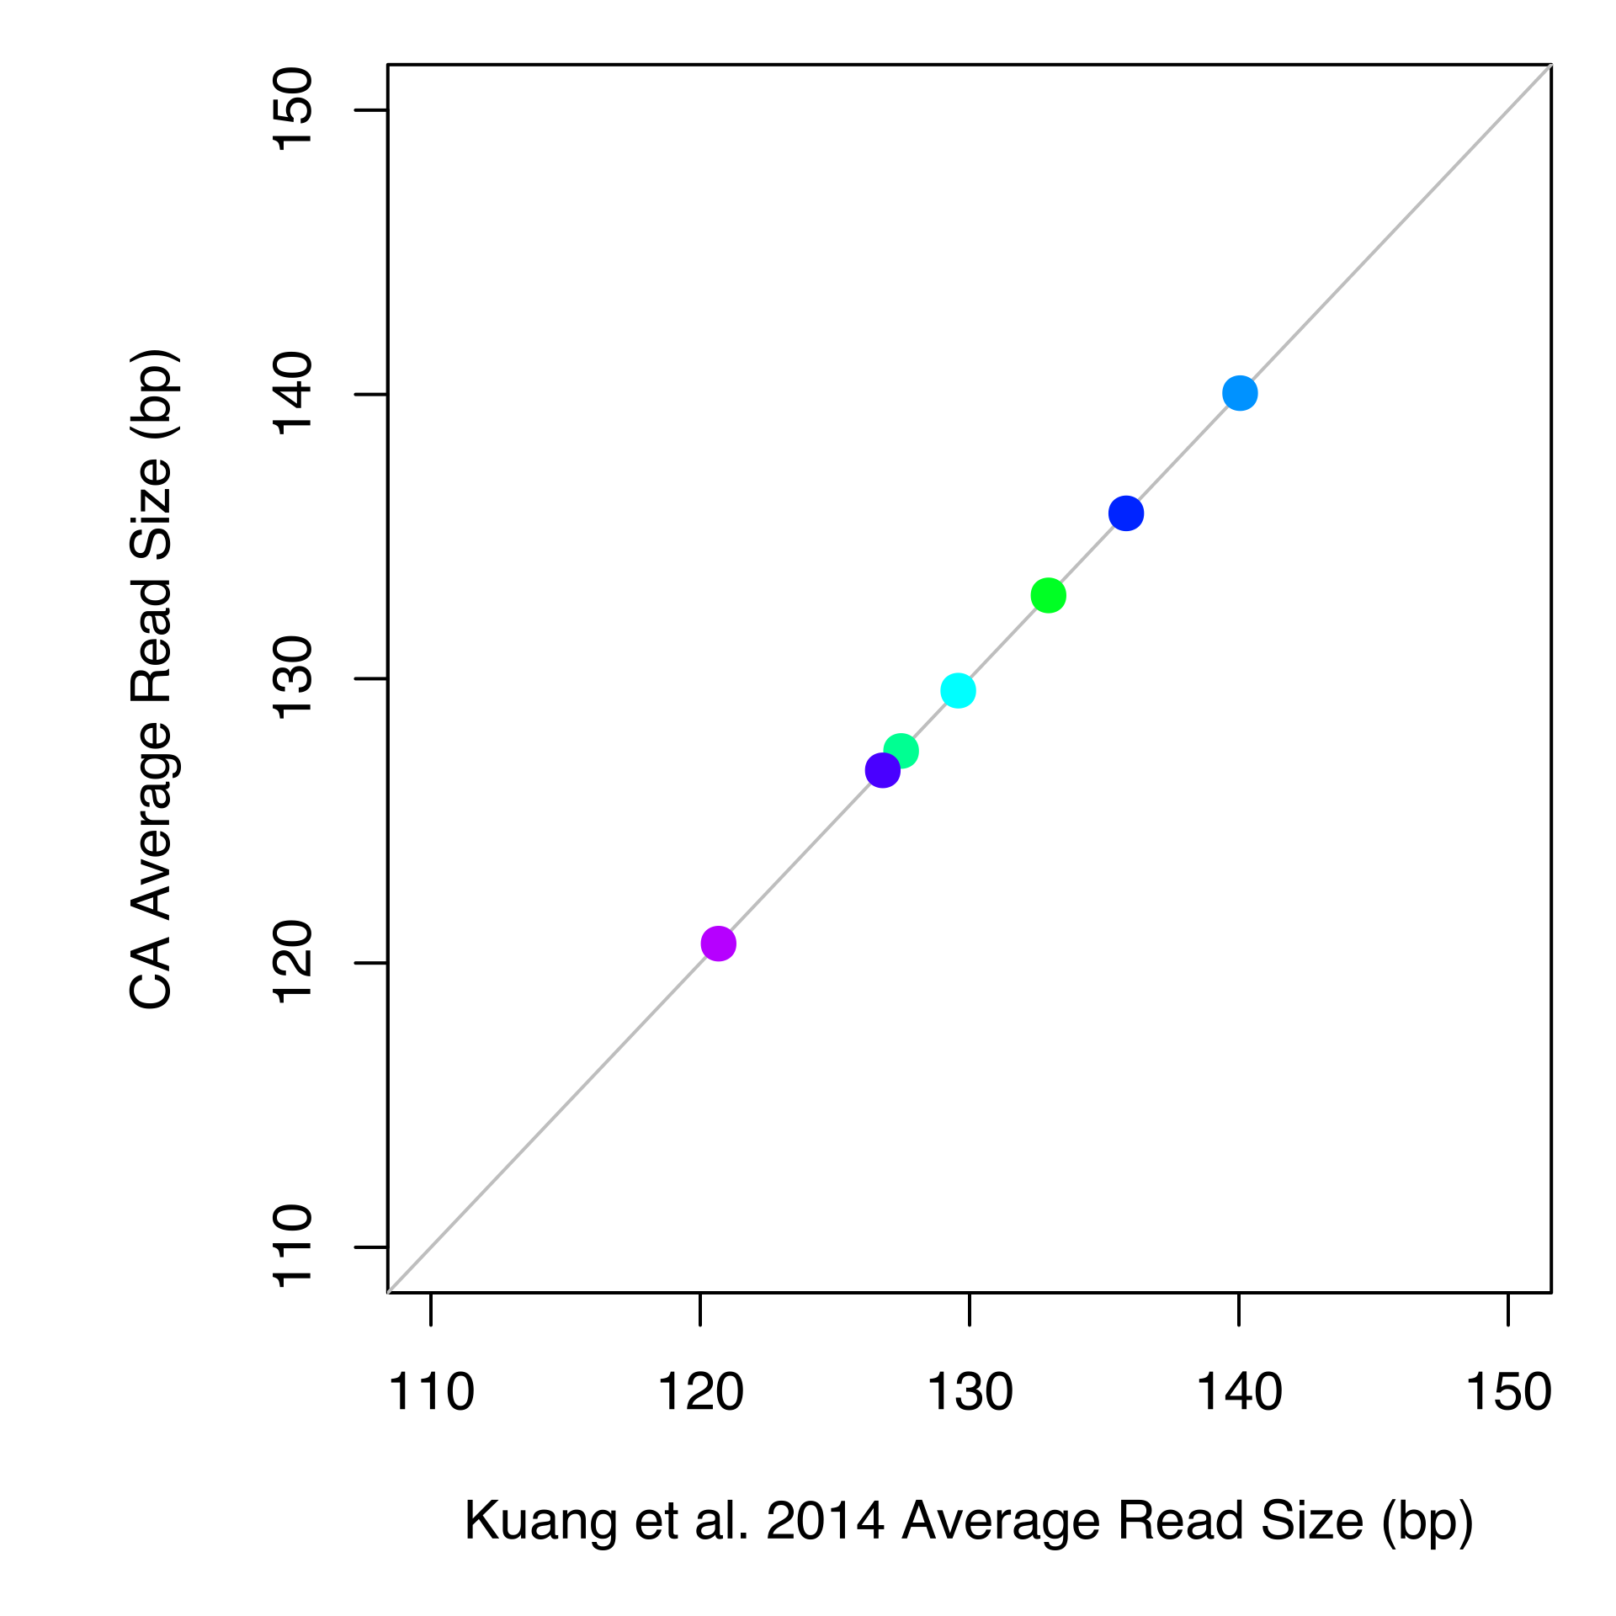
FastQC
Remove adapters & low-quality reads
Merge Lanes
Trim Galore
Remove adapters and
low-quality reads
Remove duplicate reads from PCR
Parse reads to each locus
Assemble reads into contigs
Merge loci with more than one contig
Compare sequences to O. nilotics genome
Multiple sequence alignment

Slide 8
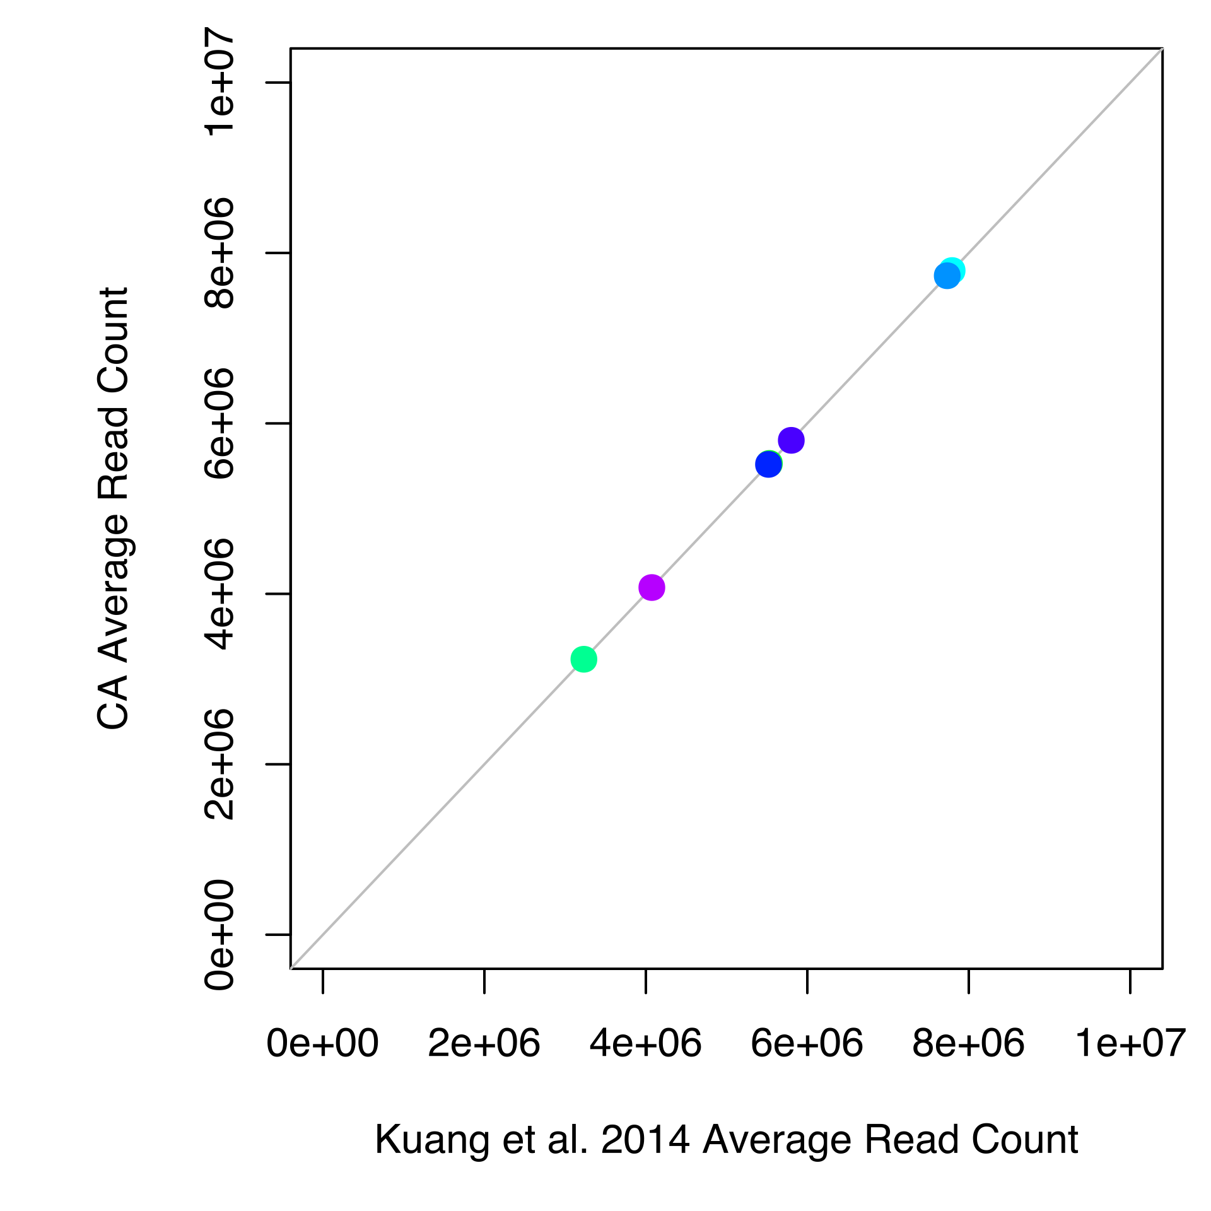
FastQC
Remove duplicate
reads
Custom
Perl Script
Merge Lanes
Remove adapters and
low-quality reads
Remove duplicate reads from PCR
Parse reads to each locus
Assemble reads into contigs
Merge loci with more than one contig
Compare sequences to O. nilotics genome
Multiple sequence alignment

Slide 9
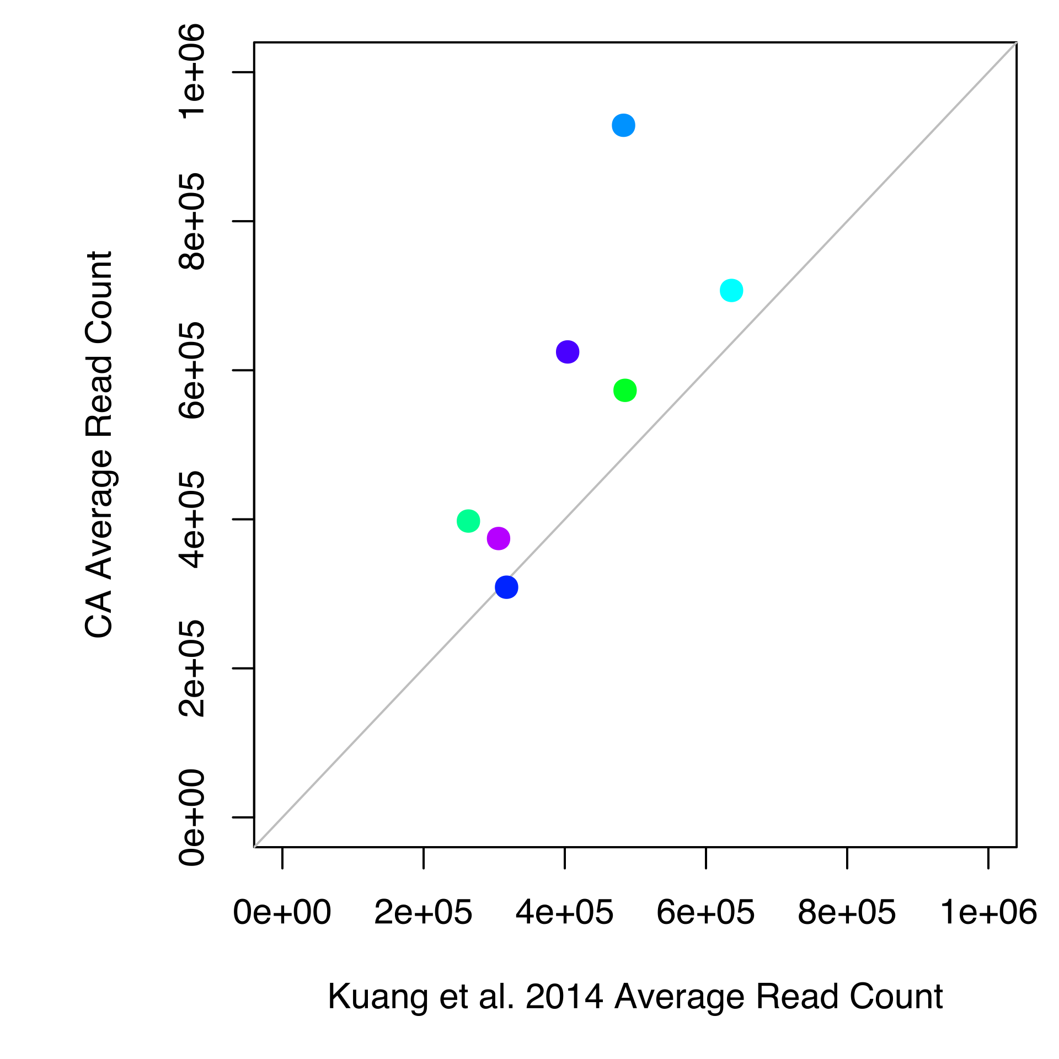
FastQC
Parse reads to
each locus
Custom
Perl Script
Merge Lanes
Remove adapters and
low-quality reads
Remove duplicate reads from PCR
Parse reads to each locus
Assemble reads into contigs
Merge loci with more than one contig
Compare sequences to O. nilotics genome
Multiple sequence alignment

Slide 10
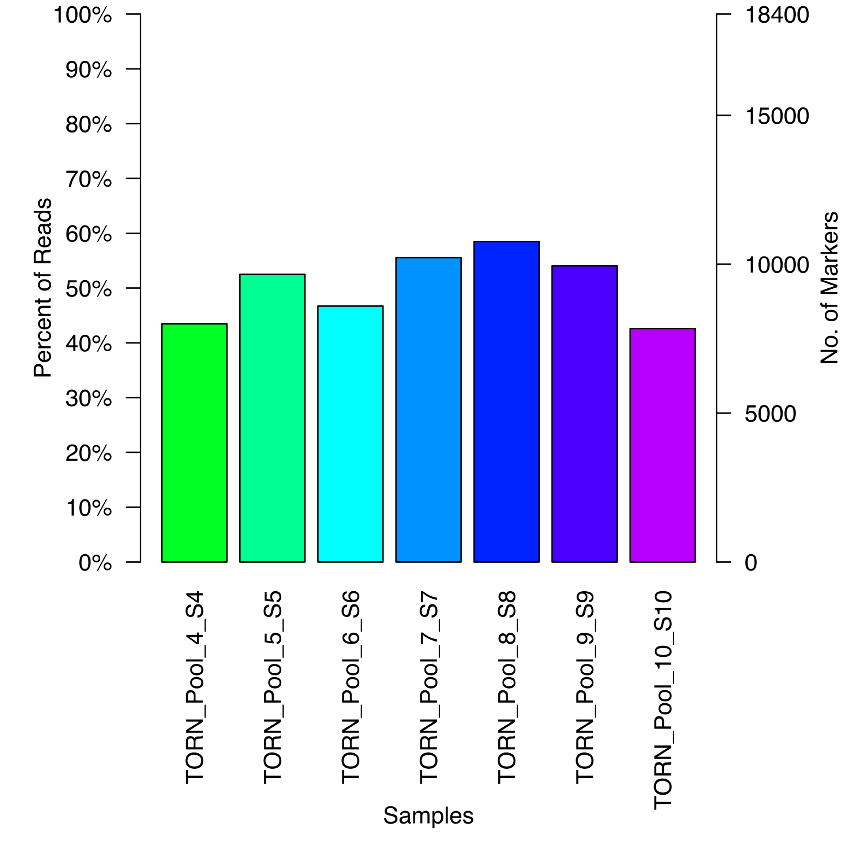
FastQC
Parse reads to
each locus
Custom
Perl Script
Merge Lanes
Remove adapters and
low-quality reads
Remove duplicate reads from PCR
Parse reads to each locus
Assemble reads into contigs
Merge loci with more than one contig
Compare sequences to O. nilotics genome
Multiple sequence alignment

Slide 11
FastQC
Assemble reads into contigs
Merge Lanes
Trinity
Remove adapters and
low-quality reads
Still not able to run Trinity…
Remove duplicate reads from PCR
Many Issues:
Parse reads to each locus
Problems installing on GitBash
Many other required programs
Input file naming convention contains unusual characters
Running from custom Perl script
Trinity must be an environmental variable when run from Perl script
Perl script was out of date
Memory issue?
Assemble reads into contigs
Merge loci with more than one contig
Compare sequences to O. nilotics genome
Multiple sequence alignment

Slide 12
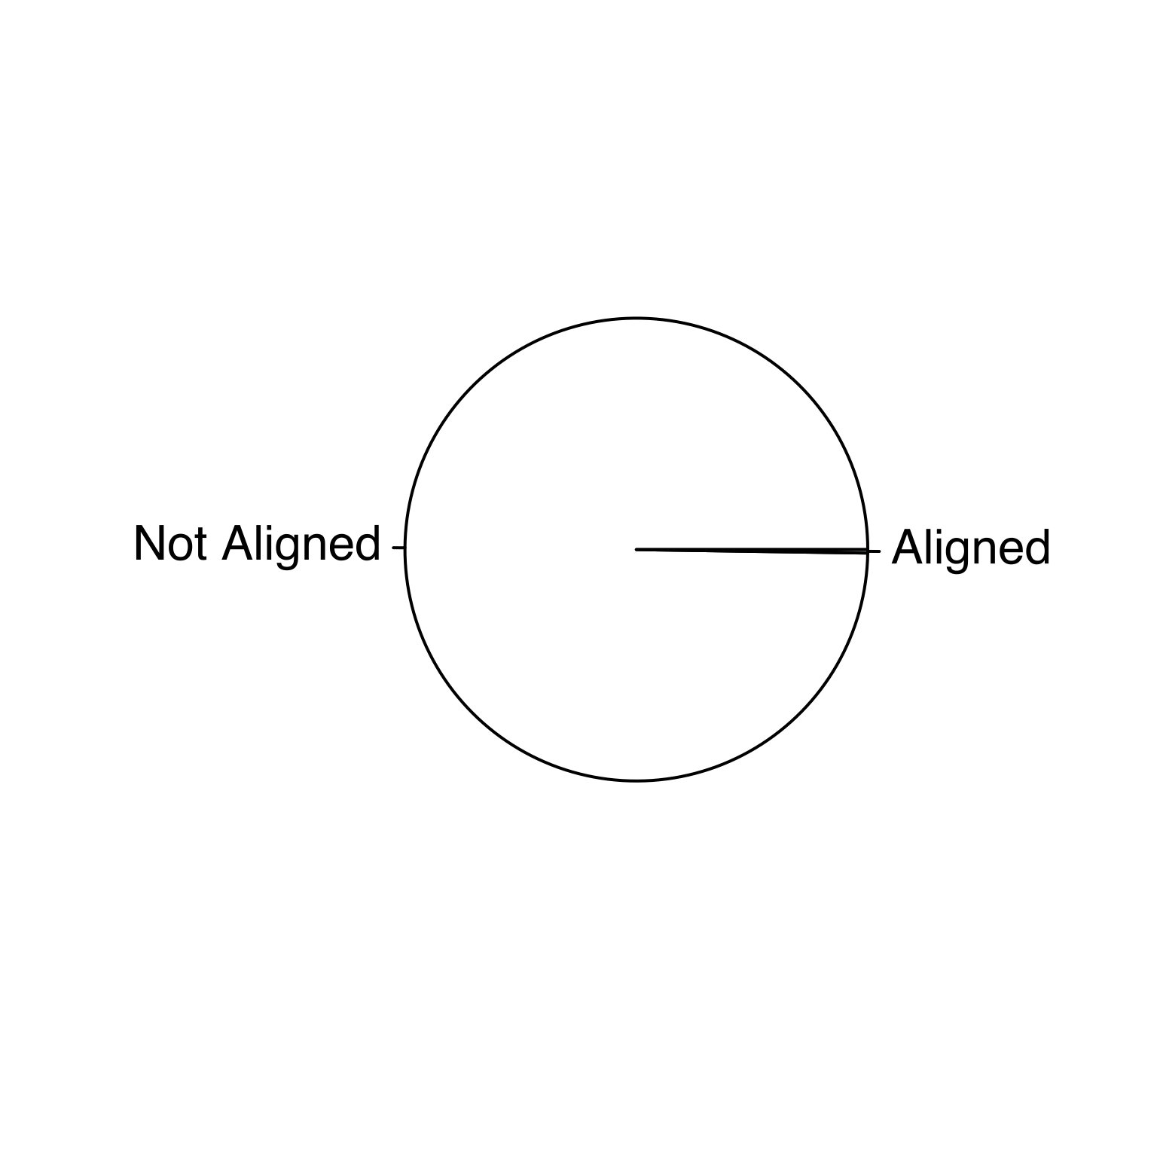
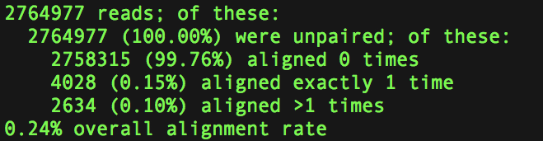
Trouble-shooting with Bowtie2
(99.75%)
(0.025%)

Slide 13
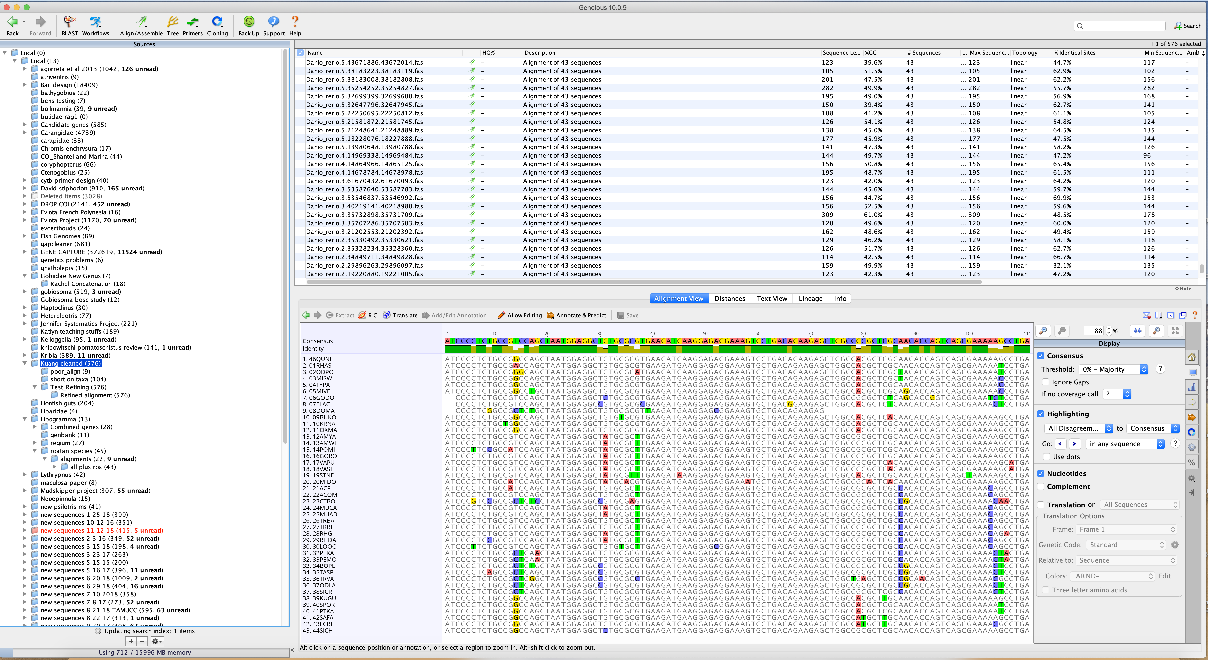

Slide 14
Next Steps
Continue exploring alignment using Bowtie
Complete the rest of the protocol (ongoing)
Run protocol on flatfish data (Dec. 2018)
Workshop on methods in Shanghai (Jan. 2019)
Get results for flatfish data (Jan. 2019)

